Slide 1

Face recognition
Triplet loss
deeplearning.ai

Slide 2
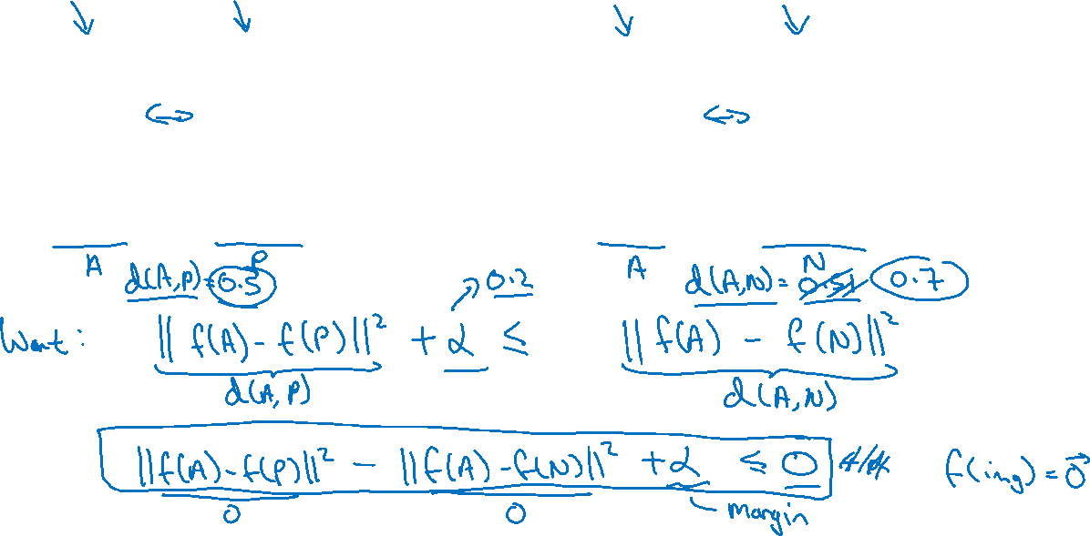
Learning Objective
Anchor
Positive
Anchor
Negative
[Schroff et al.,2015, FaceNet: A unified embedding for face recognition and clustering]

Slide 3
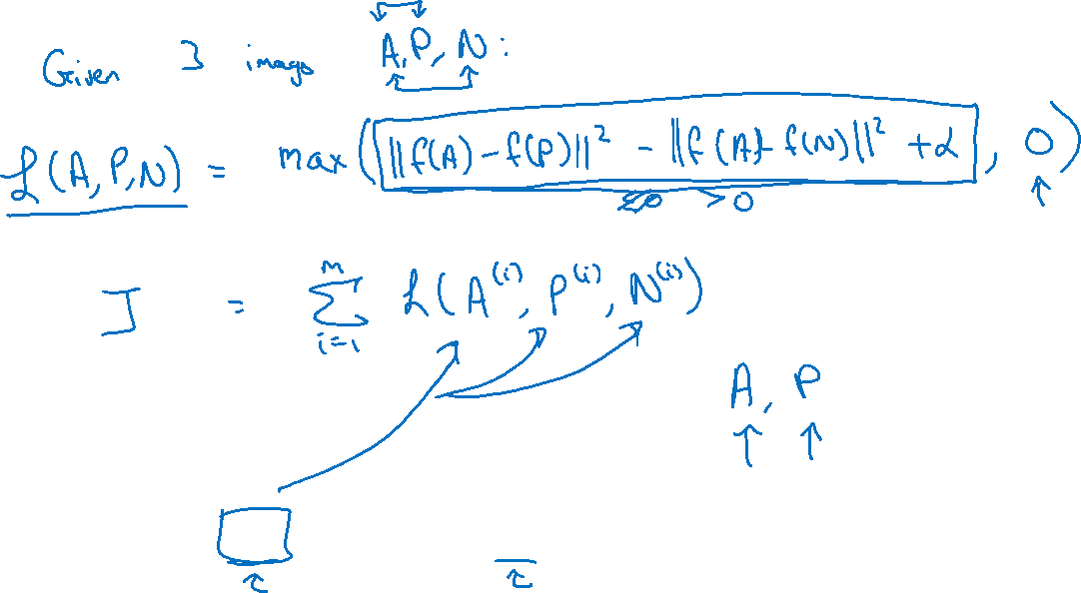
Loss function
Training set: 10k pictures of 1k persons
[Schroff et al.,2015, FaceNet: A unified embedding for face recognition and clustering]

Slide 4
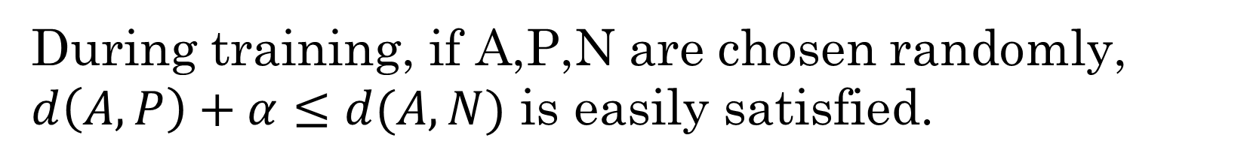
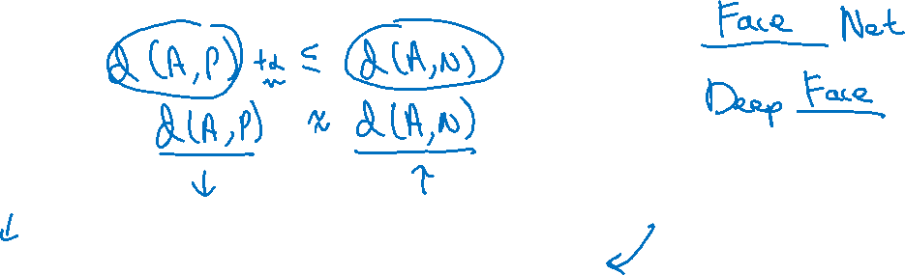
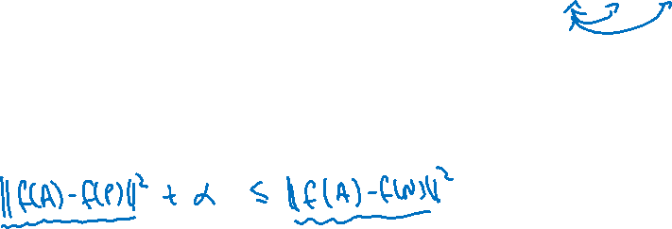
Choosing the triplets A,P,N
During training, if A,P,N are chosen randomly, $d\left(A,P\right)+α≤d(A,N)$ is easily satisfied.
Choose triplets that’re “hard” to train on.
[Schroff et al.,2015, FaceNet: A unified embedding for face recognition and clustering]

Slide 5
Why hard?
b/c randomly chosen mean d(A,N) can easily become much larger than d(A,P) + alpha=> the neuron network not learning anything.

Slide 6
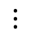
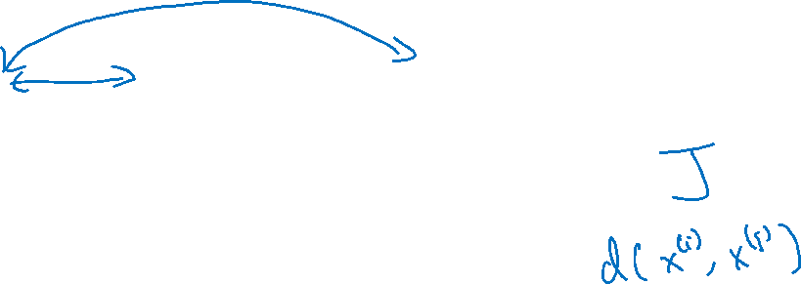
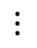
Training set using triplet loss
Anchor
Positive
Negative
$$⋮$$
$$⋮$$
$$⋮$$

